Slide 1
Sprint 4 - Presentation
Brandon Benanti, Josh Tesser, Xabien Loor

Slide 2
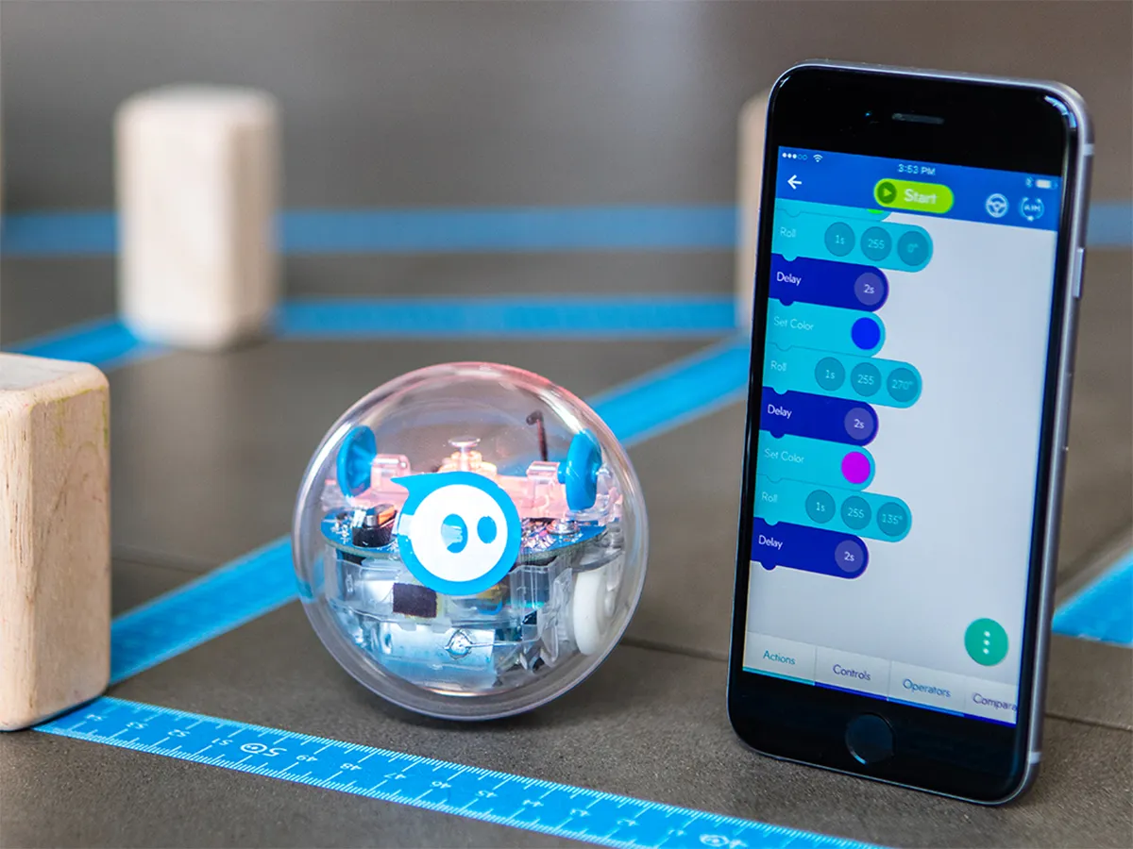
Challenges We Faced
Robot Connection Issues
Getting the right measurements for the block code (Speed/Time)
Availability

Slide 3

Roles
Gantt Chart and Block Code- All group members
Build Requirements Table, Algorithm, Flowchart, SDD- Brandon
Sensor Data, Staffing Plan, Video- Xabien
Test Table, Repository- Josh

Slide 4


What we learned about Software Engineering
From this project we learned the following about software engineering:
It takes more than one person to complete a project
Time management is your key to success
Communication is a vital aspect of completing these projects
There is a lot of trial and error in completing your task
You must have an understanding of what you have to do
It is very time consuming
All information can be found in the System Design Doc

Slide 5

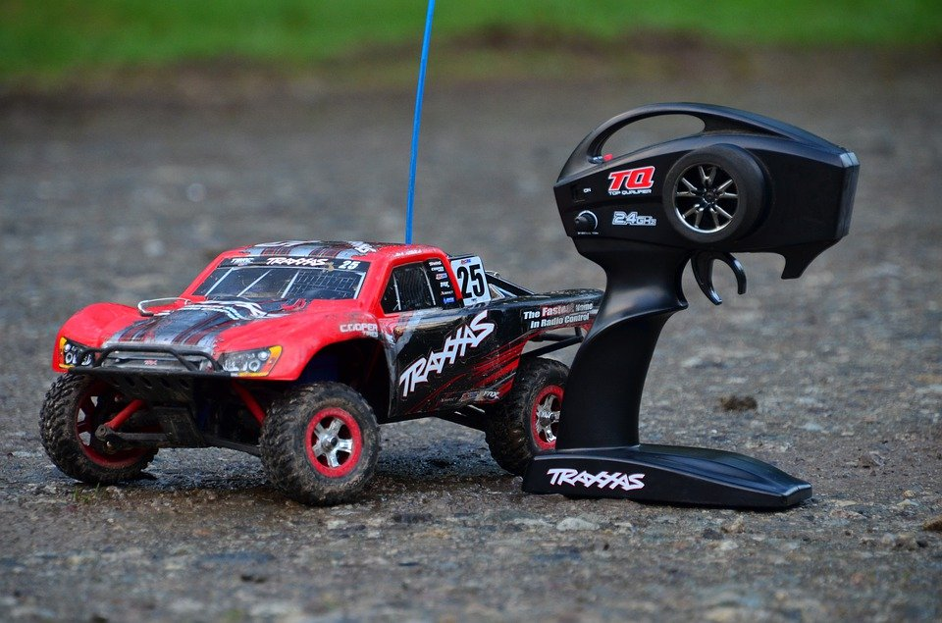
What would we do differently?
Make sure the robot is charged
Work around each other’s schedules
RC Car?

Slide 6
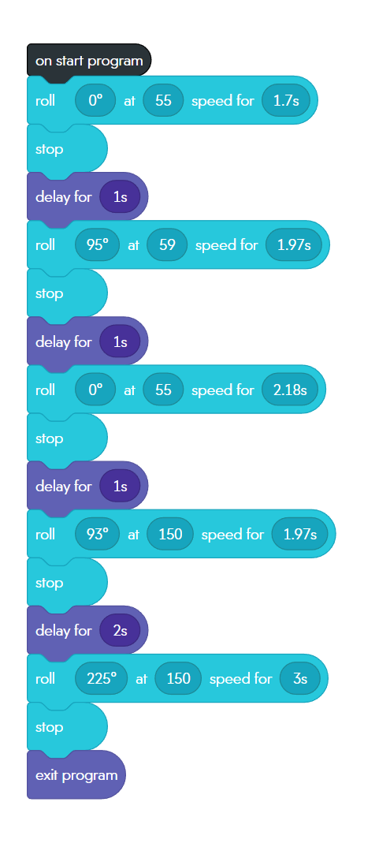

Block Code for Sprint 3

Slide 7
Agility Sprint Video
https://youtube.com/shorts/7Fp-tRpyRcg?feature=share

